Slide 1
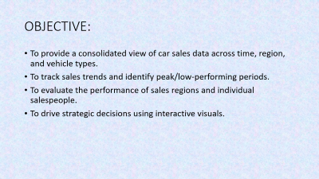
CAR SALES DASBOARD
By Akshita Parekh

Slide 2
OBJECTIVE:
To provide a consolidated view of car sales data across time, region, and vehicle types.
To track sales trends and identify peak/low-performing periods.
To evaluate the performance of sales regions and individual salespeople.
To drive strategic decisions using interactive visuals.

Slide 3
Data Overview:
Data Source: Kaggle car sales Data
Key Fields:
Sales Date
Vehicle Category / Model
Region / Dealership
Salesperson Name
Customer Segment (if applicable)
Car ID
Price($)
Color
ETC

Slide 4
Regional Sales Distribution:
Map visual displays total sales across different regions
High-performing areas are highlighted with darker shades
Enables identification of:
Sales hotspots (e.g., Urban vs Rural)
Underperforming territories needing attention

Slide 5
Salesperson Performance:
Pie chart rank salespeople by:
Number of vehicles sold
Total revenue generated
Identifies top performers and performance gaps
Useful for recognition, benchmarking, and training

Slide 6
Gender-Based Insights:
Who Buys More: Male vs Female
Pie or bar chart shows sales split by gender
Helps understand customer demographics and target marketing
“Males account for 65% of purchases — potential opportunity to target females via promotions”

Slide 7
Top 10 Customers:
Table or bar chart with customer names and total purchase value
High-value individuals/organizations can be targeted for loyalty rewards
Helps with VIP segmentation and relationship management

Slide 8
Bottom 10 Customers:
Identifies customers with lowest purchase volume
Can be used to analyze churn risk or upsell opportunities
Use case: “Re-engage low-value customers via personalized offers”

Slide 9
Conclusion
The dashboard provides a unified, filterable view of sales metrics
Supports regional, individual, and demographic performance evaluation
Enables data-driven decisions and proactive strategy adjustments
Next Steps:
Share with sales leaders
Monitor monthly
Use for campaign planning and territory alignment

